Slide 1
Living With Freedom
‘the truth will set you free’ JOHN 8:32

Slide 2
Being free to be who God made you to be
Living With Freedom 01

Slide 3
Being free to be who God made you to be
IDENTITY
IMPORTANT
Living With Freedom 01

Slide 4
Being free to be who God made you to be
Our feelings about ourselves
IDENTITY
IMPORTANT
Living With Freedom 01

Slide 5
Being free to be who God made you to be
Our feelings about ourselves
IDENTITY
IMPORTANT
Our confidence to achieve our goals
Living With Freedom 01

Slide 6
Being free to be who God made you to be
Our feelings about ourselves
IDENTITY
IMPORTANT
Our confidence to achieve our goals
Our general behaviour
Living With Freedom 01

Slide 7
Being free to be who God made you to be
Our feelings about ourselves
IDENTITY
IMPORTANT
Our confidence to achieve our goals
Our general behaviour
Our thoughts about others
Living With Freedom 01

Slide 8
Being free to be who God made you to be
Our feelings about ourselves
IDENTITY
IMPORTANT
Our confidence to achieve our goals
Our general behaviour
Our thoughts about others
Our treatment of others
Living With Freedom 01

Slide 9
Being free to be who God made you to be
IDENTITY
SHAPERS
Living With Freedom 01

Slide 10
Being free to be who God made you to be
Family and Culture of origin
IDENTITY
SHAPERS
Living With Freedom 01

Slide 11
Being free to be who God made you to be
Family and Culture of origin
IDENTITY
SHAPERS
Good and / or bad words spoken to and over us
Living With Freedom 01

Slide 12
Being free to be who God made you to be
Family and Culture of origin
IDENTITY
SHAPERS
Good and / or bad words spoken to and over us
Good and /or harm done to us
Living With Freedom 01

Slide 13
Being free to be who God made you to be
Family and Culture of origin
IDENTITY
SHAPERS
Good and / or bad words spoken to and over us
Good and /or harm done to us
Good and / or bad things happening
Living With Freedom 01

Slide 14
Being free to be who God made you to be
Family and Culture of origin
IDENTITY
SHAPERS
Good and / or bad words spoken to and over us
Good and /or harm done to us
Good and / or bad things happening
Our own failures and / or successes
Living With Freedom 01

Slide 15
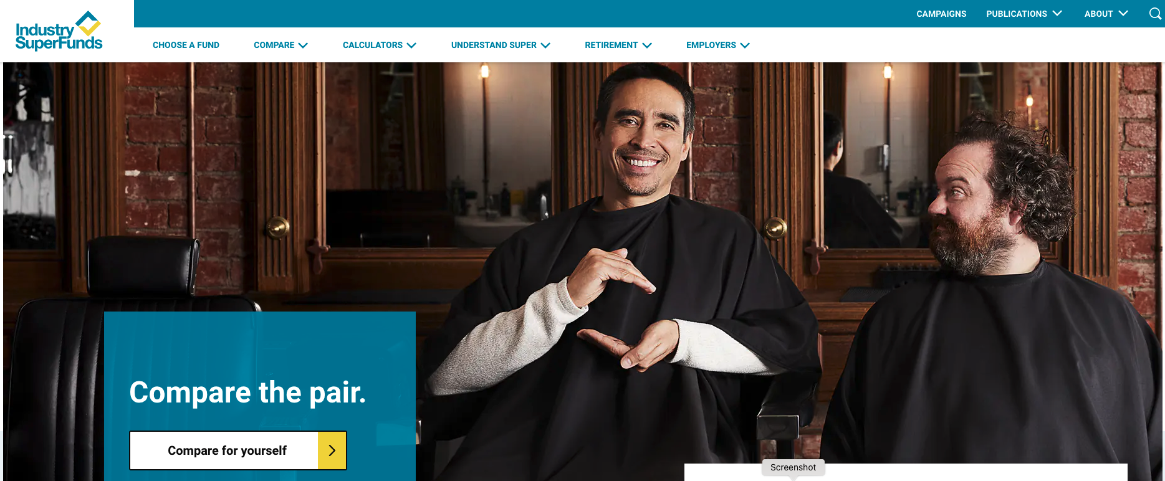
Being free to be who God made you to be
*Past performance is not a reliable indicator of future performance.
https://www.industrysuper.com
Living With Freedom 01

Slide 16
Being free to be who God made you to be
IDENTITY
The past does not have to be an indicator of future failure
Living With Freedom 01

Slide 17
Being free to be who God made you to be
IDENTITY
The past does not have to be an indicator of future failure
We are all to some degree products of our past, but we do not have to be prisoners to it
Living With Freedom 01

Slide 18
Being free to be who God made you to be
ADOPT
GOD’S VIEW
OF YOU
Living With Freedom 01

Slide 19
Being free to be who God made you to be
Created in his image: GENESIS 1:27
ADOPT
GOD’S VIEW
OF YOU
Living With Freedom 01

Slide 20
Being free to be who God made you to be
Created in his image: GENESIS 1:27
ADOPT
GOD’S VIEW
OF YOU
Sinner God loves: GEN.3:1-24 & ROM. 3:23
Living With Freedom 01

Slide 21
Being free to be who God made you to be
Created in his image: GENESIS 1:27
ADOPT
GOD’S VIEW
OF YOU
Sinner God loves: GEN.3:1-24 & ROM. 3:23
God’s child through faith: JOHN 1:1-13
Living With Freedom 01

Slide 22
Being free to be who God made you to be
Created in his image: GENESIS 1:27
ADOPT
GOD’S VIEW
OF YOU
Sinner God loves: GEN.3:1-24 & ROM. 3:23
God’s child through faith: JOHN 1:1-13
Having different natural abilities: GENESIS 4:19; EXODUS 28:4; 35:30-34; ACTS 9:39; 16:14; 18:1-4; COLOSSIANS 4:14
Living With Freedom 01

Slide 23
Being free to be who God made you to be
Created in his image: GENESIS 1:27
ADOPT
GOD’S VIEW
OF YOU
Sinner God loves: GEN.3:1-24 & ROM. 3:23
God’s child through faith: JOHN 1:1-13
Having different natural abilities: GENESIS 4:19; EXODUS 28:4; 35:30-34; ACTS 9:39; 16:14; 18:1-4; COLOSSIANS 4:14
Having different spiritual abilities:
1 CORINTHIANS 12
Living With Freedom 01

Slide 24
Being free to be who God made you to be
An IDENTITY shaped by God’s view …
Regards everyone with respect
Living With Freedom 01

Slide 25
Being free to be who God made you to be
An IDENTITY shaped by God’s view …
Regards everyone with respect
Is content in its God-given abilities without striving to be someone else
Living With Freedom 01

Slide 26
Being free to be who God made you to be
An IDENTITY shaped by God’s view …
Regards everyone with respect
Is content in its God-given abilities without striving to be someone else
Values others and the different contribution they make
Living With Freedom 01

Slide 27
Being free to be who God made you to be
An IDENTITY shaped by God’s view …
Regards everyone with respect
Is content in its God-given abilities without striving to be someone else
Values others and the different contribution they make
Living With Freedom 01

Slide 28
Being free to be who God made you to be
An IDENTITY shaped by God’s view …
Regards everyone with respect
Is content in its God-given abilities without striving to be someone else
Values others and the different contribution they make
Is teachable and learns from constructive criticism
Living With Freedom 01

Slide 29
Being free to be who God made you to be
An IDENTITY shaped by God’s view …
Regards everyone with respect
Is content in its God-given abilities without striving to be someone else
Values others and the different contribution they make
Is teachable and learns from constructive criticism
Does not need to control others to feel good about themselves
Living With Freedom 01

Slide 30
Being free to be who God made you to be
An IDENTITY shaped by God’s view …
Regards everyone with respect
Is content in its God-given abilities without striving to be someone else
Values others and the different contribution they make
Is teachable and learns from constructive criticism
Does not need to control others to feel good about themselves
Does not need the constant affirmation of others
Living With Freedom 01

Slide 31
Being free to be who God made you to be
An IDENTITY shaped by God’s view …
Regards everyone with respect
Is content in its God-given abilities without striving to be someone else
Values others and the different contribution they make
Is teachable and learns from constructive criticism
Does not need to control others to feel good about themselves
Does not need the constant affirmation of others
Celebrates when others succeed
Living With Freedom 01

Slide 32
Being free to be who God made you to be
HOW TO SHAPE IDENTITY WITH GOD’S VIEW
Read the Scriptures
Meditate on the Scriptures
Ask the Holy Spirit to bring them alive so you may apply them to yourself
Choose to believe what God says over what others say or have said
Constantly train your mind to think God’s way: ROMANS 12:1-2
Living With Freedom 01

Slide 33
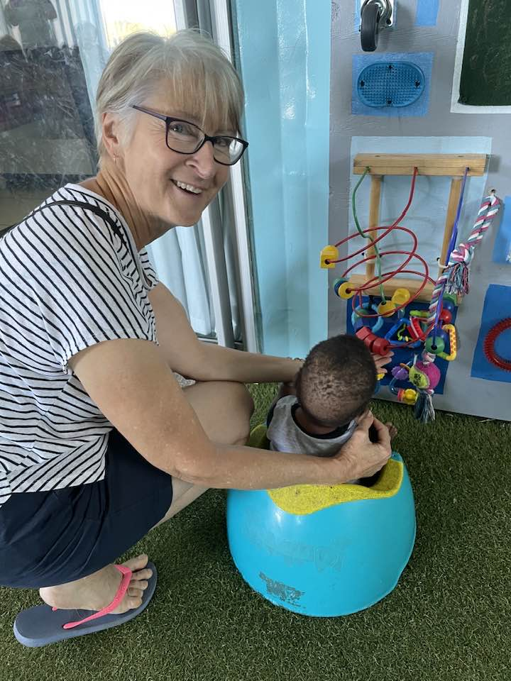
Living With Freedom
SUNDAY
NOV. 12
Being free to forgive yourself and others
SPEAKER: PETER KEEP
REPORT by IAN & BARB GRAHAM on their time volunteering at the Kings Children’s Home in South Africa

